Slide 1
Micromouse Parts
Team 28 (2020)

Slide 2
Feather Board - $20.95
Reduces complexity of PCB
Includes Wireless
Programmed with C/C++ via USB
I²C Communication (For sensors)
Many ADC + DAC for controls
Built-in PWM
Fast

Slide 3
Battery 3.7v (4.2) - $9.95
1000mah (long battery)
Rechargeable via feather’s built-in circuits
Can power feather when no USB is available
Relatively compact

Slide 4
ToF Sensors - $13.95
Use I²C Communication
Digital
Can have multiple on same bus
Compatible with Arduino Feather
Library support
Compact

Slide 5
Motors - $18.95
Very compact
Powerful relative to size (1W)
Fast
Includes gearbox
Compatible with wide range of wheels
Compatible with encoders

Slide 6
Motor Controller - $3.42
Dual Motor Controller
Controls up to 2 motors simultaneously
Configurable to control motor rpm

Slide 7
Magnetic Encoder - $7.95
Allows for precise rpm configuration
Compatible with motors

Slide 8
Encoder Wires - $0.95
Six pin female connector
Goes well with encoder in BOM

Slide 9
Wheels - $6.75
We will need multiple different sets of wheel in order to incorporate flexibility into to the prototype design.
Different surfaces, (carpet, tile, counter)
Relatively small price
In case of axle problems (with encoders) enters’ are all plastic

Slide 10
DC/DC Booster 3.7to12V - $2.99
Steps battery voltage supply up to 12V
Motor Controller operates on 12V
Outputs a constant 12V.

Slide 11
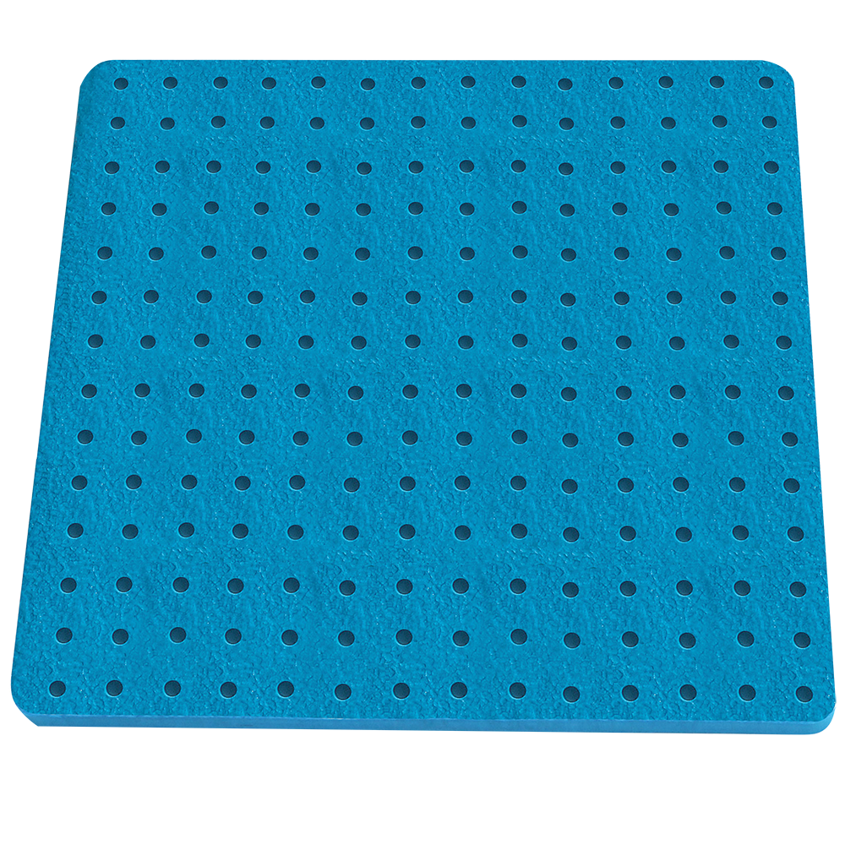
Maze - $(Undecided)
Modular Design
Portability
Peg board type with corners

