Slide 1
Senior Design: Micro Mouse
By Aaron, Austin, Joshua, Jorge, Richard, Tyler

Slide 2
Overview of the Technical Challenge(s) - Joshua
“Working remotely”
Building software without hardware tests
Building Prototype 1 design
Limited availability to resources
Tools
Programs
Advise

Slide 3
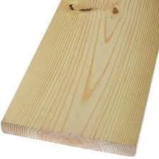
Maze & GUI - Tyler
Can continue working on the maze
Tiles have been cut
Old plan had to change
Hand Drill
GUI
Output to the Micro mouse

Slide 4
Challenge: Working Remotely with Hardware Solution: Virtualization - Aaron
Since we have all split up, we still need a way to “build” a micromouse without actually being physically present
Use the Unity game engine to simulate a micromouse
Communicate via a socket to “virtual” hardware
Allows us to design software with a lack of hardware
Have to integrate realistic assets
Utilize Unity’s physics engine to simulate what we want
Notes:
Hello, I’m Aaron and I’m going to be talking about the technical challenges with working remotely, specifically with using the hardware. As we face our current technical challenge, we came up with the solution to build our micromouse in a virtual environment. This allows us to all participate in creating code for the micromouse even though only one of us has hardware for it.
For the implementation itself, we plan to use sockets to communicate with the Unity engine. The hardware will have “virtual stubs” that will be abstract enough to allow drop in replacements with actual hardware. The Unity physics engine will take care of simulating the sensors, wheels, and maze. Once we finish programming the project virtually, it will be an easy swap to run the code on actual hardware.

Slide 5
PCB Design
Our experience with PCB’s are minimal
We have chosen to work on Eagle
Software that was chosen for use.
During this time we will be practicing
Practice individulay
Regrouping to work as a whole through webex or zoom
Notes:
My name is Jorge Gomez, and for this slide I will be talking about our current plans for the PCB. Our experience level as a collective when it comes to PCB design is minimal. In order to become more familiar with the process we have decided to take this time and build up this skill. We started off by choosing a program to work with. In this case we chose to work on EAGLE. The reason for this is that one of our team members found a guide for navigating EAGLE that was simple to follow. Now, we will be trying to learn how to use EAGLE on our own and at a later time will regroup and share our experience with each other.

Slide 6
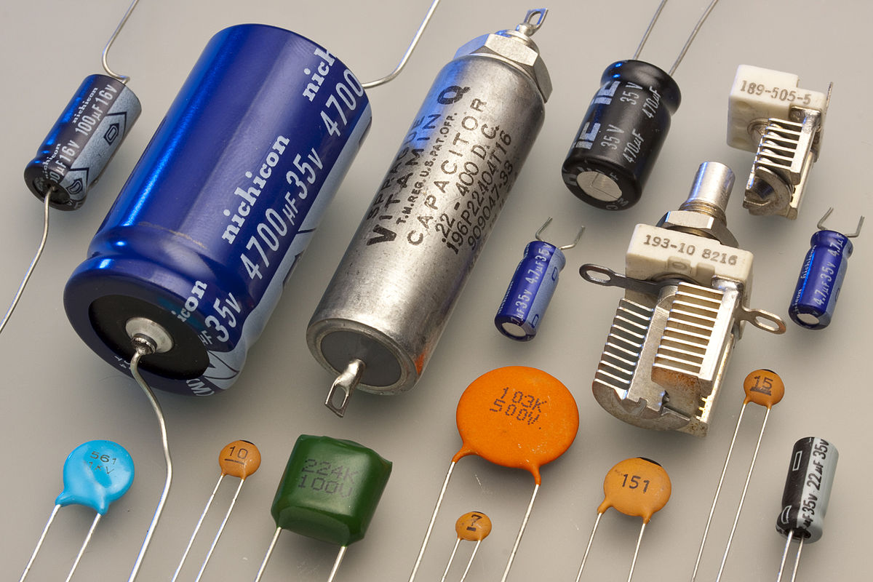
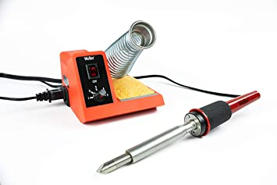
Hardware Assembly
Components are only at one location
If any components break we are unsure about replacements
Any tools that are needed may not be available
Assembly of components must be handled by one person

Slide 7
Other General Challenges
Collaboration
Coordination
Internet connection reliability
Contracting Coronavirus

