Slide 1
Senior Design: Micro Mouse
Project Plan
By Aaron, Austin, Joshua, Jorge, Richard, Tyler

Slide 2
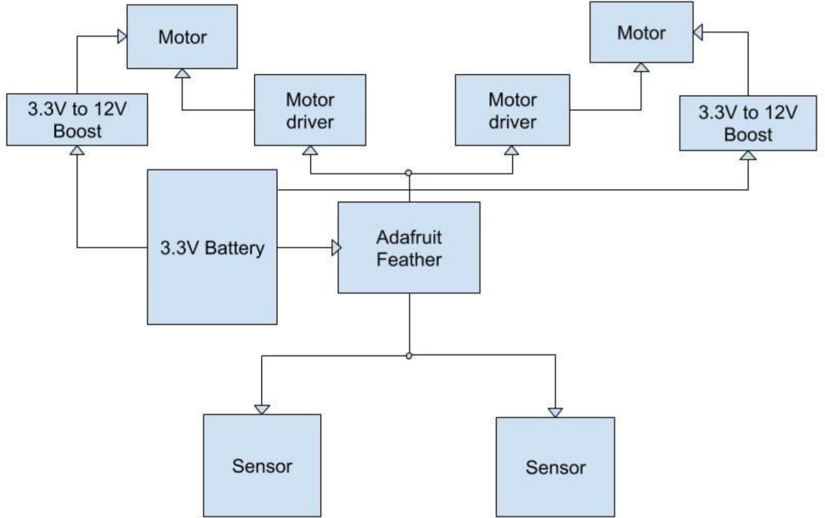
Conceptual Schematic Diagram
Build a high-level schematic to visualize the function of each component

Slide 3
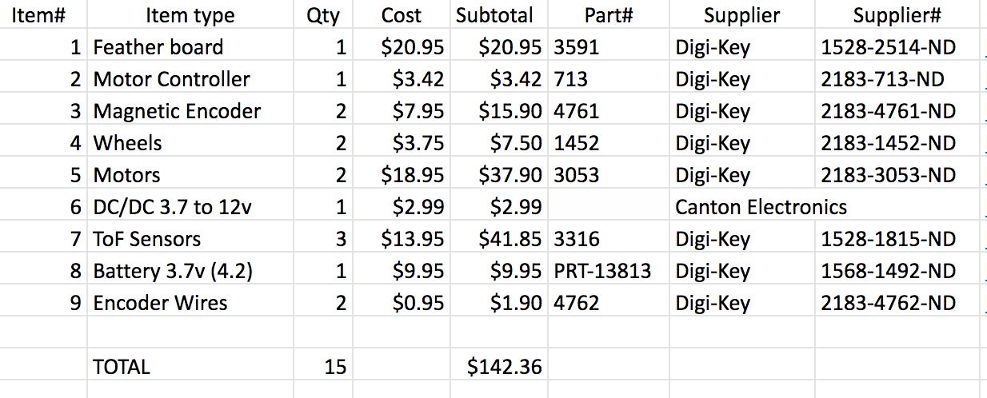
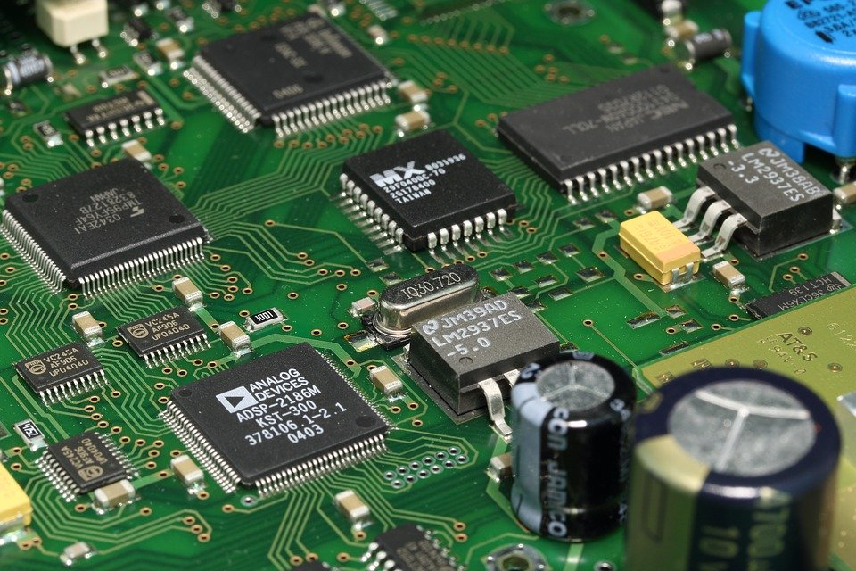
Hardware ordered vs still needed
Ordered components
Additional parts and components
PCB
Maze components

Slide 4
Establish Software
Python will be the main programming language for the entire project.
This makes things consistent between both the micromouse and the Laptop endpoint.
Arduino - Circuit Python
Hardware and MicroController module for Python
User Interface - PyQT
Graphical User Interface library for Python
Easy to construct GUIs with UI Builder
Notes:
I’m Aaron and I’m discussing the programming languages that we chose for our micromouse design. For both the micromouse and the user interface, we decided to use Python for ease of development. CircuitPython will run on the Arduino Feather and can interface with all of its hardware components. For the laptop, we will run full Python with PyQT to make the UI. This makes constructing the UI easy and makes the programming language consistent on all platforms.

Slide 5
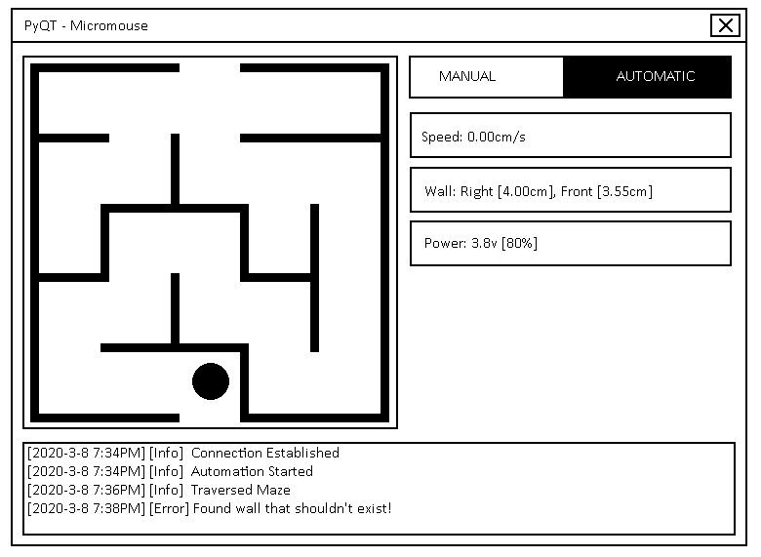
UI and Modes
Need basic UI
Debug
Maze Data
Manual
User input from keyboard / controller
Wireless
Bluetooth (Serial)
Wifi (Socket/TCP based)
Automatic
Maze pathfinding algorithm
Notes:
My name is Richard Anderson and this is the UI and the Modes for our micromouse.
Our UI will likely be the same for both modes, but could potentially have different sections.
The two sections we have decided on so far are a Debugging section, which displays mouse info and errors, and a Maze Data section, which will display mouse speed, nearby wall distances, and remaining mouse power.
We will also have a switch for users to swap between manual and automatic modes.
The first mode of these two modes would be the manual mode, where users will either use the keyboard of the computer connected to the micromouse, or just a wireless controller to move the mouse around.
The computer will be able to communicate with the mouse either using Bluetooth, which would use a serial connection, or Wifi, which would use sockets or UDP.
We plan to use only one of either Bluetooth or Wifi, but we’ll try both and see which is easier to use, and is more suitable for our project
The second mode will be the automatic mode, where user input is no longer used and the mouse must navigate the maze by itself using its sensors.
The mouse will go through the maze once to map a model of a maze, and then use a pathfinding algorithm to go through the maze as fast as possible.

Slide 6
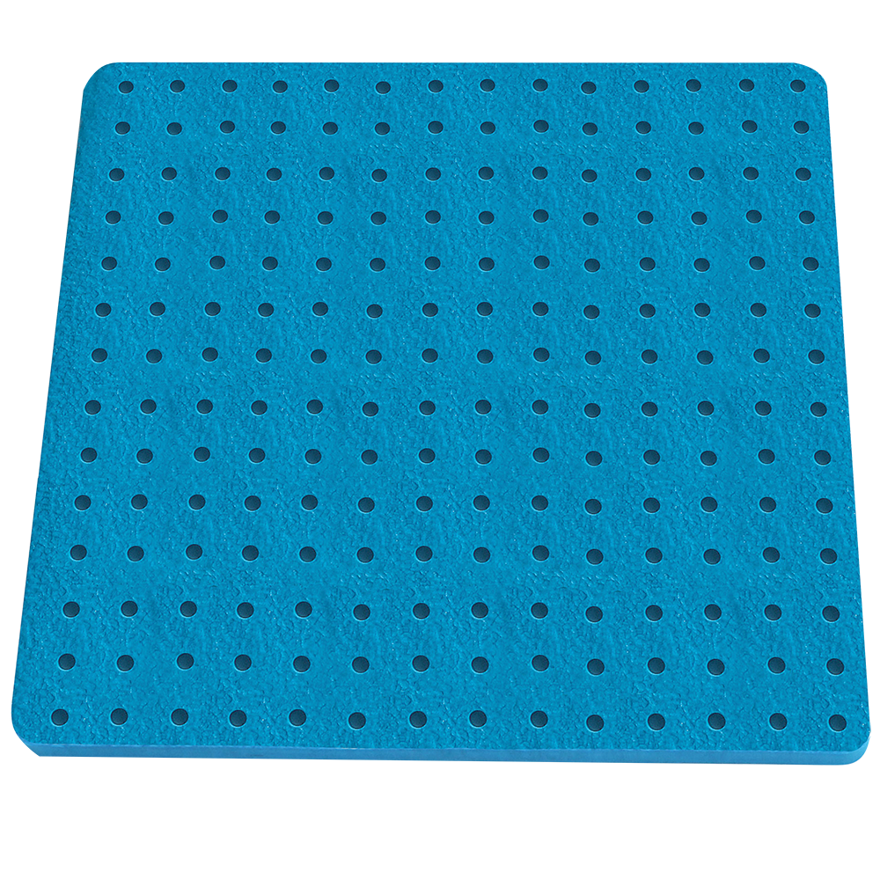
Maze Design
Peg Board design
Modularity
Portability
1” x 8” x 8” boards

Slide 7
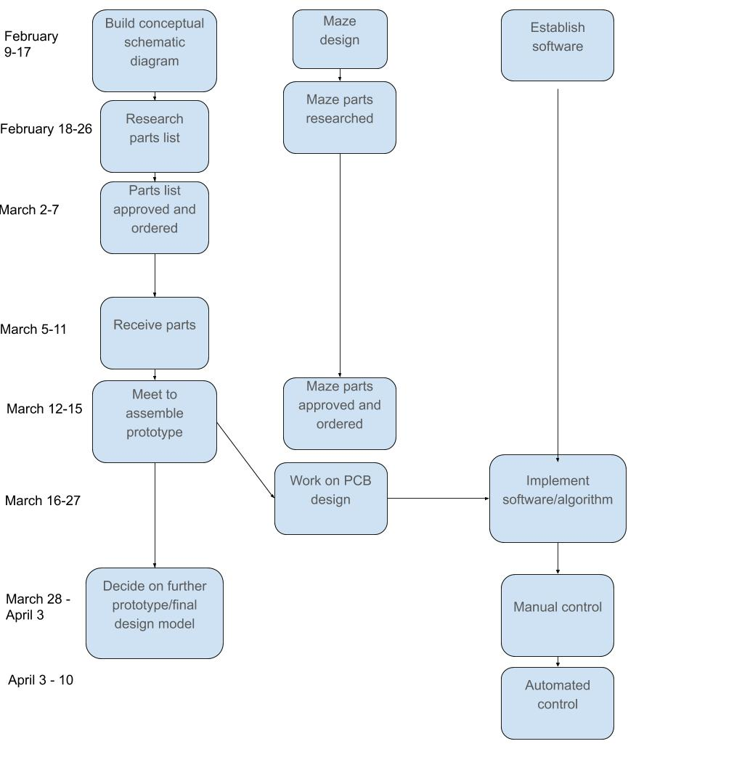
Timeline
Micro mouse teams’ current timeline
Tentative timeline
Currently waiting on receiving parts (March 12-15)
Spring break, breaking our workflow
PCB / software implementation is the next major milestone
Will make appropriate changes to timeline if needed
Notes:
The micro mouse team has met for the past couple of weeks in order to discuss what you see in the chart to the left. Currently we are waiting for our parts to arrive. The current timeline is subject to change due to spring break but we will be staying in touch in order to stay on the same page.
Build conceptual schematic diagram
Research parts list
Parts list approved and ordered
Establish software
Maze design
Receive parts
Meet to assemble prototype.
Work on PCB design
Implement software/algorithm
Decide on further prototype/final design model
Manual control
Automated control

