Slide 1
Senior Design: Micro Mouse
By Aaron, Austin, Joshua, Jorge, Richard, Tyler

Slide 2
Micromouse Description & Outcome Jorge
A micro mouse is a small autonomous robot that must find its way through a maze in the shortest amount of time possible.
The outcome is to display the final project in different places such as elementary schools or ISU.

Slide 3
Wheels & Maze Tyler
Requirements:
Wheels size
Grip strength
Dynamic
Portable
Recommendation:
Wheels
Maze

Slide 4
uController Joshua
Requirements:
UART - Communications
ADC - IR sensors, DC Motor
CAN - Control system
Low latency - >80MHz
Recommendation:
STM32L433RCT6P ($6.34)

Slide 5
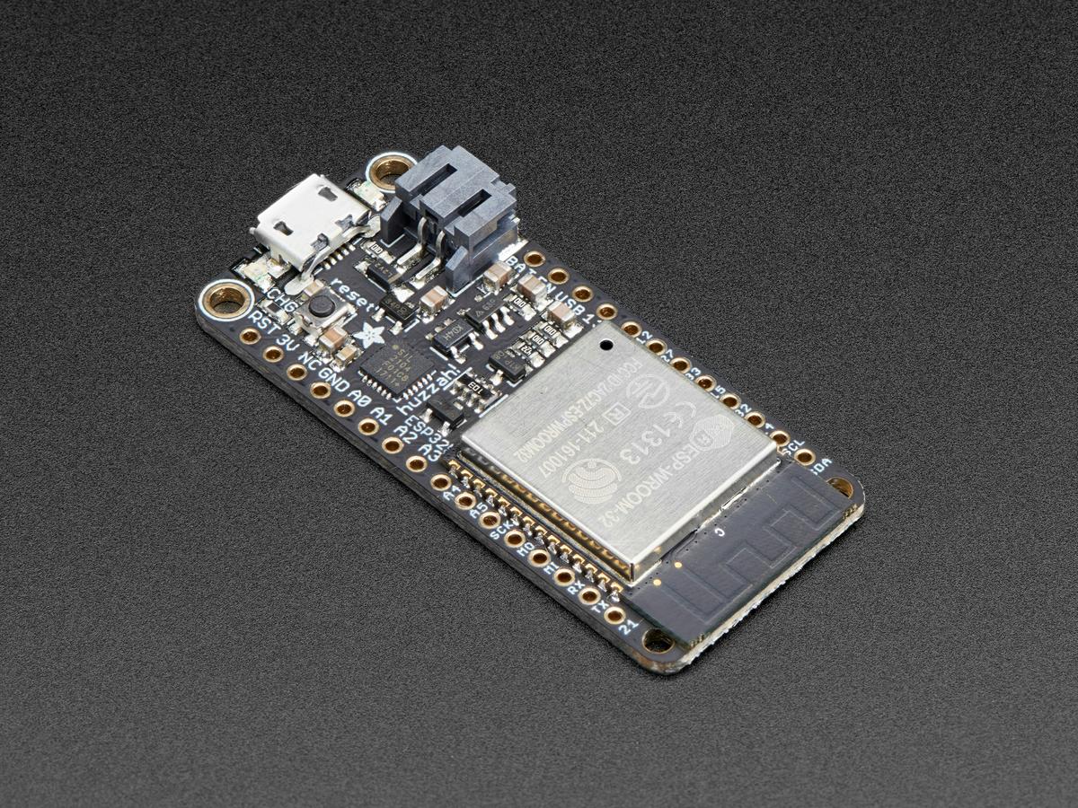
Feather Aaron
Prototype Micromouse
Before moving to a standalone microcontroller, we plan to use an all-in-one SoC for the micromouse.
Recommendation: HUZZAH32 - ESP32
Wireless (Wifi + Bluetooth + Bluetooth LE)
Charges batteries (Li Ion/Poly)
Supports complex code (520 KB SRAM)
Lots of headers (Including ADCs/DACs/PWM)
Communication (I²C support)
Small
Fast (240 MHz dual core)

Slide 6
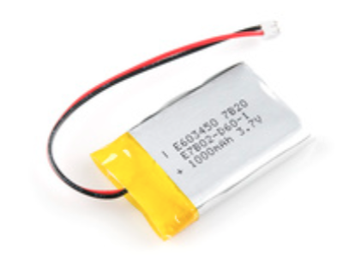
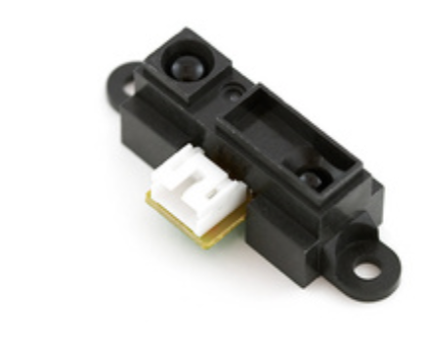
Battery, PCB, Motors and Sensors
Requirements
Battery type - 1000 mAh -Lithium Ion batteries
Sensors - Infrared Proximity Sensor Short Range
PCB - designed in either eagle or cadence( Primarily used for integration of sensors with microcontroller)
Motors - DC motors
Recommendations
Battery - DTP603450 : Polymer Li-ion Rechargeable Battery
Sensors - Sharp GP2Y0A41SK0F
Notes:
This might be a smaller sensor: https://www.st.com/en/imaging-and-photonics-solutions/vl6180x.html
(Time of Flight, Digital)

Slide 7
Approach to algorithm Richard
Exploration Phase
Depth First Search
Solving Phase
Flood Fill
Breadth First Search

Slide 8
Parts List/Economics Richard
Micro-Controller: ($6.34 - Potential for final design)
Feather: ($19.95 - For prototype)
PCB: (TBD)
Sensors
Encoders: (TBD)
IR: ($8.74)
Wheels:
Pololu Wheel 60 x 8mm ($4.25)
Solarbotics Hard Plastic Wheels 30 mm x 7 mm($1.00)
Motors
Controller: ($3.33)
DC: ($2.95)
Batteries: ($9.50)
Maze: (TBD)
Notes:
For approximations i found the cheapest and “expensive” parts and averaged it. (excluding chinese parts) links used were posted in the “parts list” doc that was shared.

